Slide 1
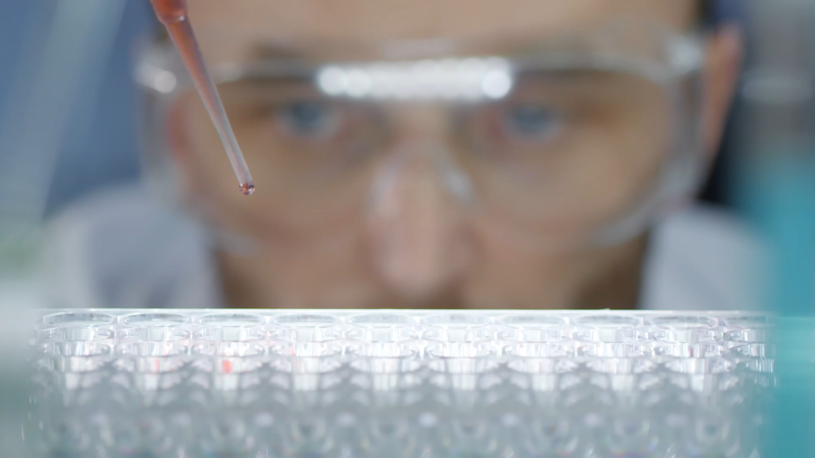
Analyzing the effectiveness of a new drug for the treatment of solid tumour
Theophilus Ebode

Slide 2
Content
Introduction
Methodology
Exploratory Data Analysis and Findings
Interpretation of results
Conclusion

Slide 3
Content
Introduction
Methodology
Exploratory Data Analysis and Findings
Predictive model development
Conclusion
Interpretation of results
Power BI dashboard

Slide 4
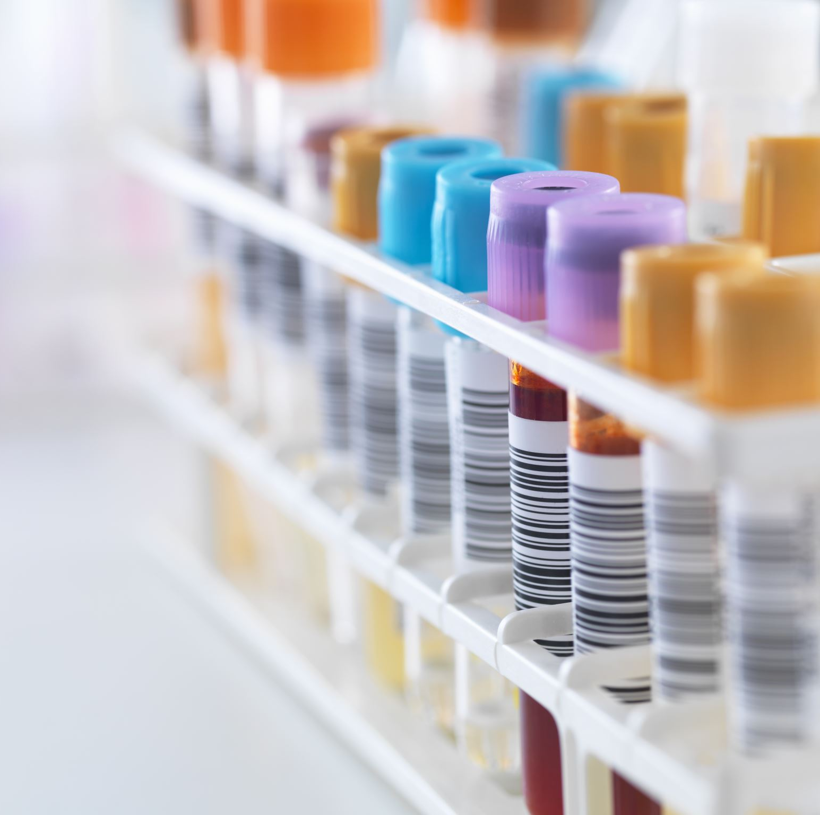
Introduction
A global pharmaceutical company with established presence in the UK is developing a new drug for the treatment of solid tumour. The drug has passed late phase of clinical trials and has shown potentials. For privacy, the drug is referred to as miraculon-B

Slide 5
Objective
The objective of this project is to analyze the clinical trial data to gain understanding of its effectiveness in shrinking solid tumours in patients that don’t respond to other treatments. Results of this analysis will establish the efficacy of the drug, patients that are most likely to benefit from it and identify predictive biomarkers.

Slide 6

Methodology
The dataset was analyzed in three different forms:
Data of all participants treated with both miraculon-B and control
Data of participants treated with miraculon-B
Data of participants treated with control/standard care.
Python was used for this analysis in a google Collaboratory notebook

Slide 7
Data preprocessing
The two different dataset were read into the environment and merged for this analysis. The first contains blood protein concentration of participants while the second contains records of their age, weight, sex, kind of treatment they received and their response. Thereafter some steps were implemented to clean the data.

Slide 8
Data Preprocessing
The following preprocessing steps were done before analysing the dataset:
Replacing missing values with the mean
Removing duplicates record
Removing records of participants below 18 years
Creating a calculated column, BMI

Slide 9
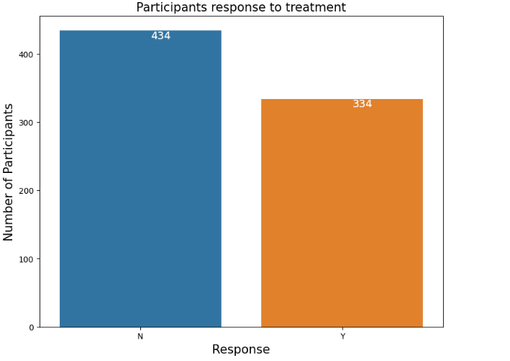
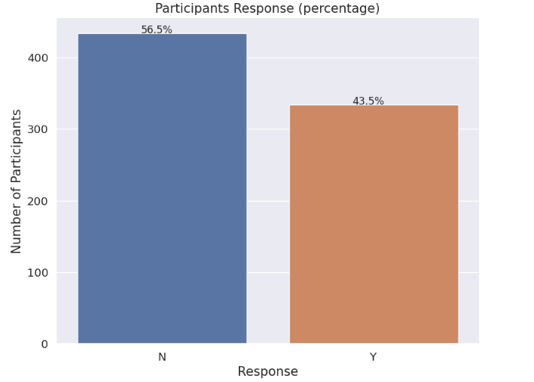
Data Analysis findings
43.5% of the participants treated with either the Miraculon-B or the standard treatment responded to treatment.

Slide 10
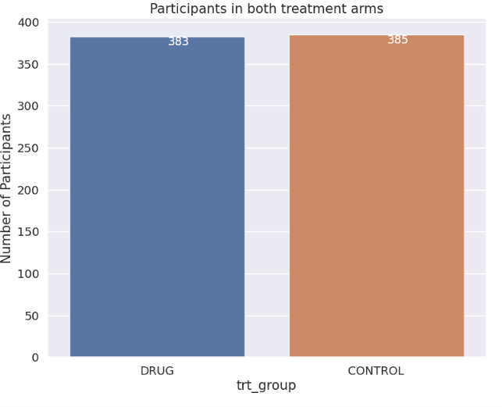
Treatment arms
The record of 768 participants were analyzed. 383 of them were treated with miraculon-B while 385 were treated with the standard care.

Slide 11
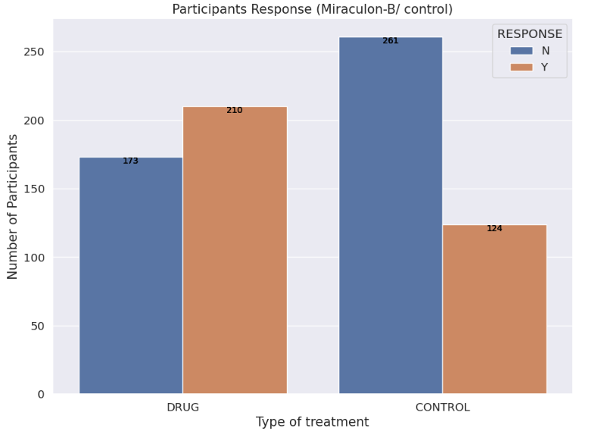
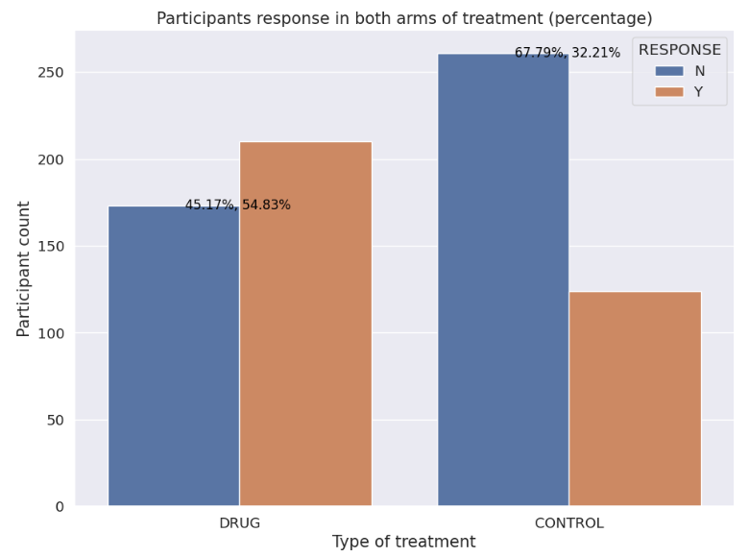
Treatment arms
210 (54.83%) of the participants treated with miraculon-B responded to treatment while only 124 (32.21%) responded with the standard treatment.

Slide 12
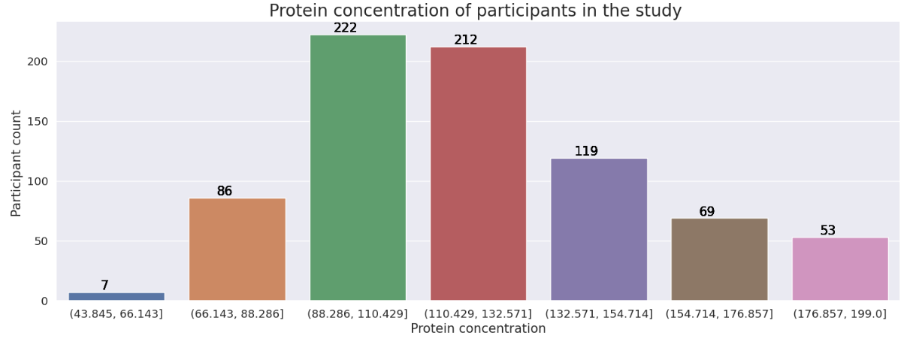
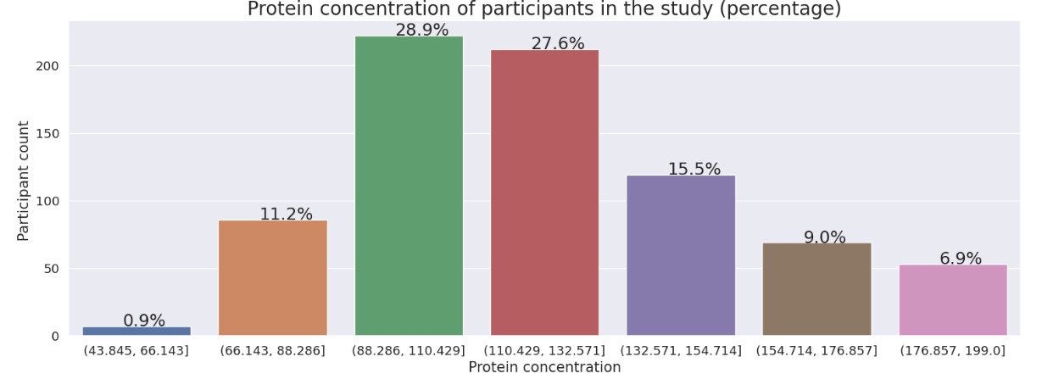
Protein concentration
Participants with protein concentration below 110.43 (ug/L) responded better. 68.9% of participants in this range responded while only 25.82% above this range responded

Slide 13
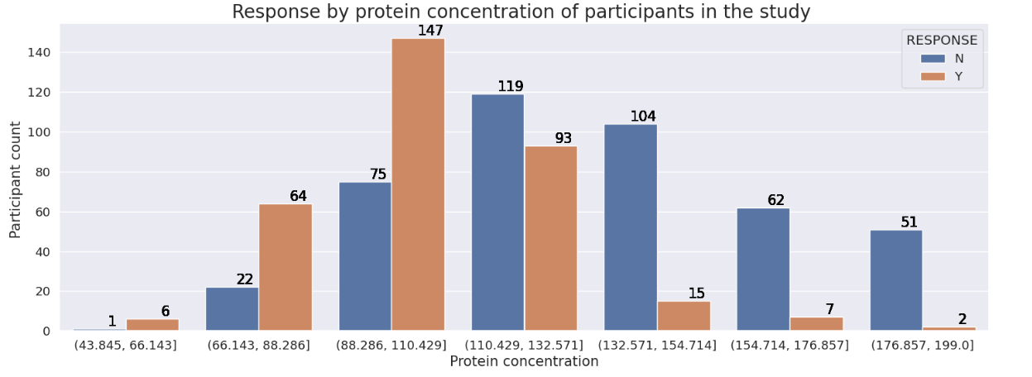
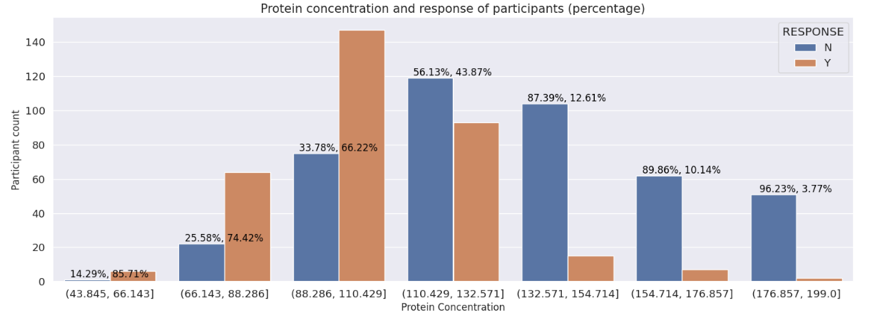
Protein concentration
Participants with protein concentration below 110.429(ug/L) responded better.

Slide 14
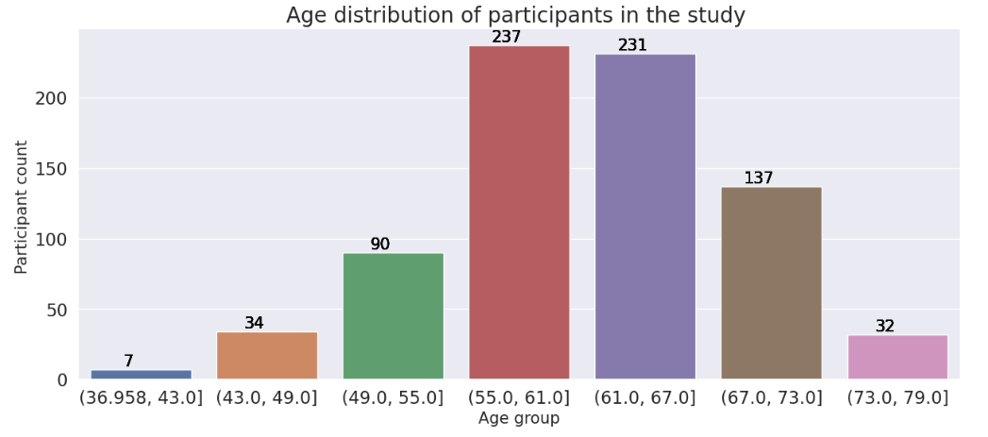
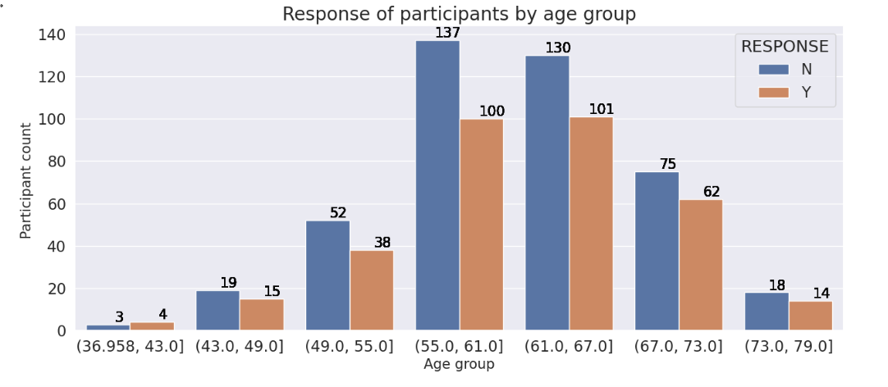
Age
468 of the participants in the study are between 55 and 67 years old. Distribution of response in the various age groups is normal

Slide 15
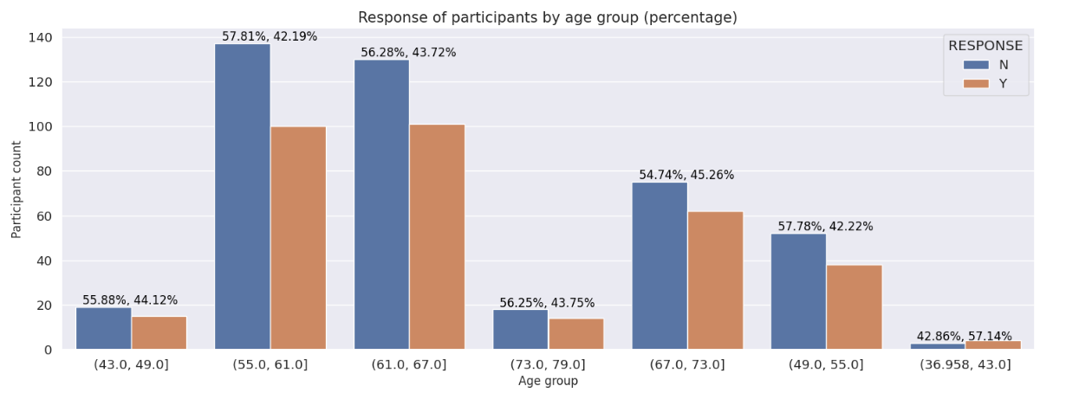
Age
The average response across the various age groups is between 42% and 45%

Slide 16
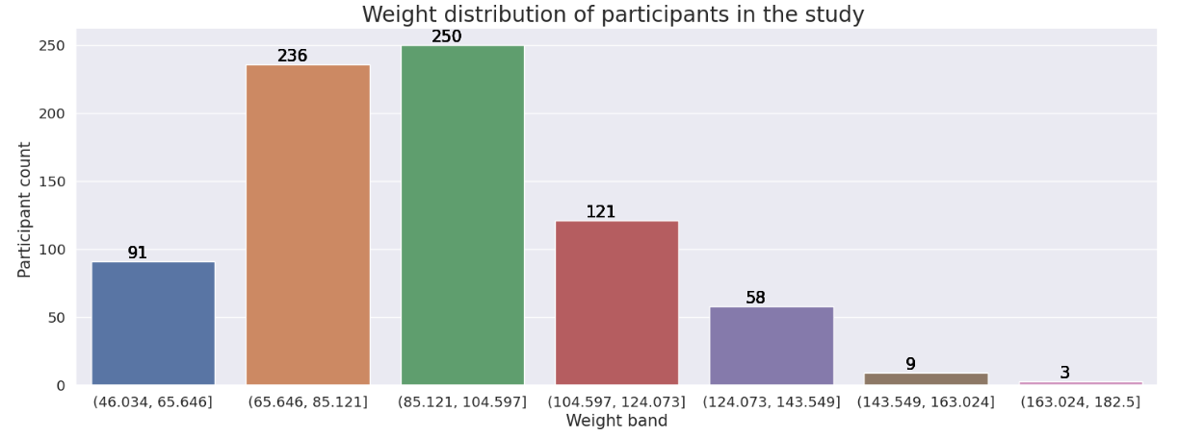
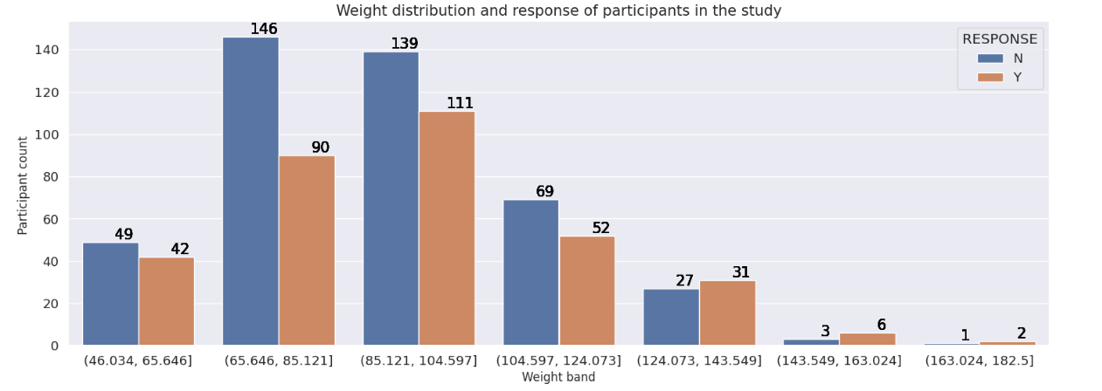
Weight
486 of the 768 participants weigh between 65.65kg and 104.60kg. The mean weight of those that responded is 93.25kg and 89.95kg for those that did not.

Slide 17
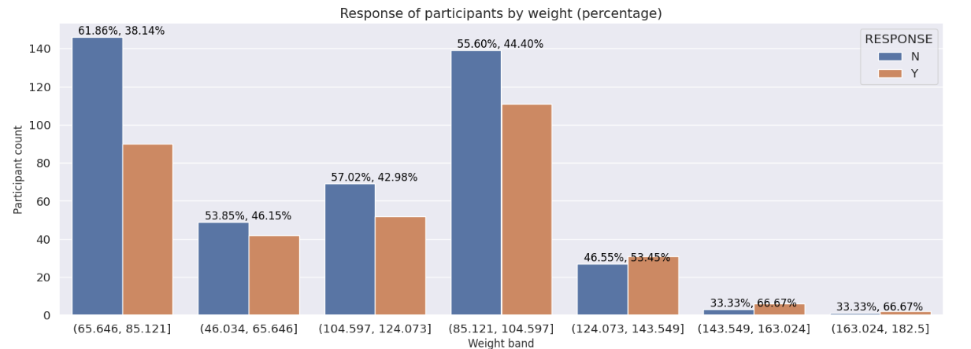
Weight

Slide 18
Analyzing data of participants treated with miraculon-B

Slide 19
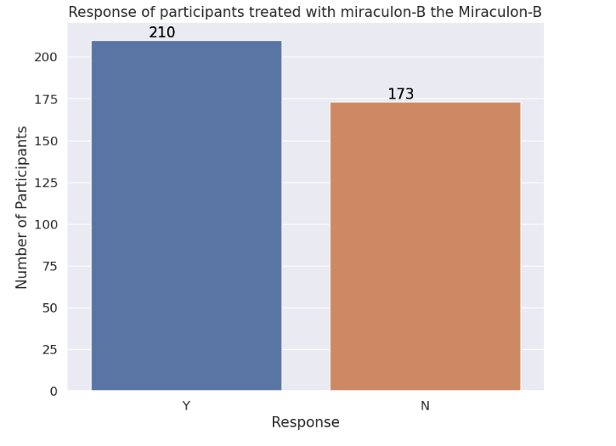
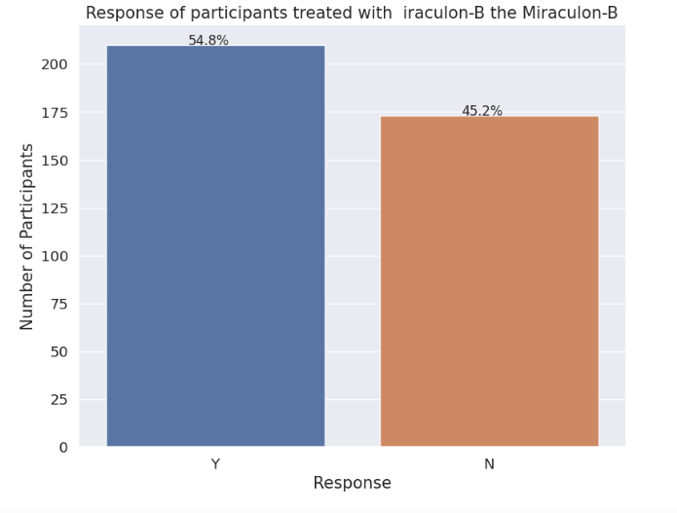
Response of participants to miraculon-B
54.8% of participants responded.

Slide 20
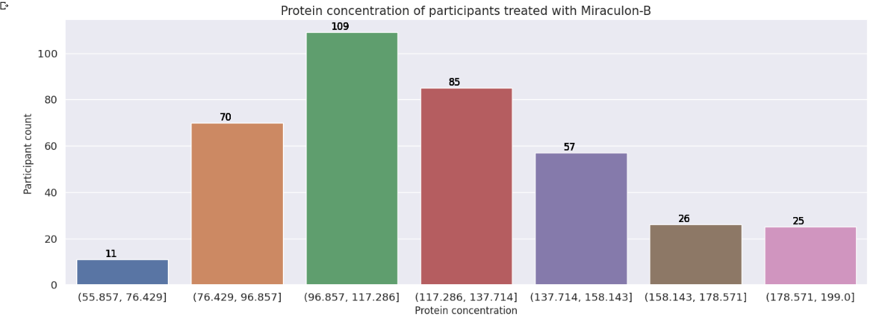
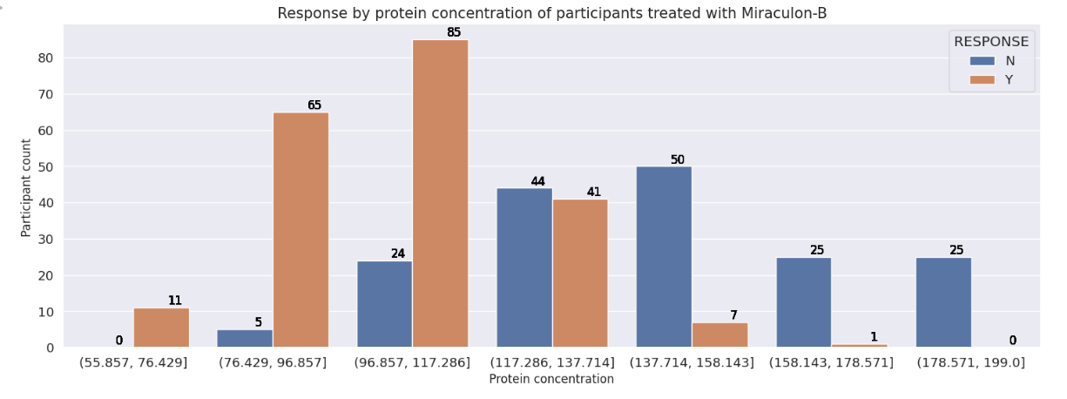
Protein concentration
264 out of the 383 participants in this treatment arm have protein concentration between 76.42(ug/L) and 137.71(ug/L)

Slide 21
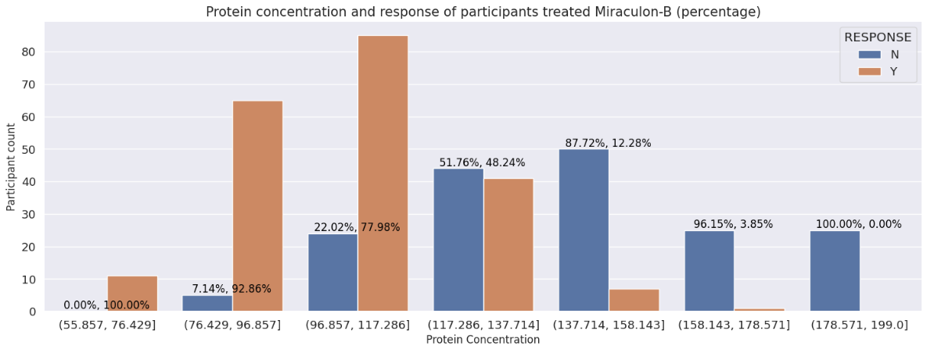
Protein concentration
All participants with protein concentration below 76.429(ug/L) responded. 92.86% of those whose had it between 76.429(ug/L) and 96.857(ug/L) responded.

Slide 22
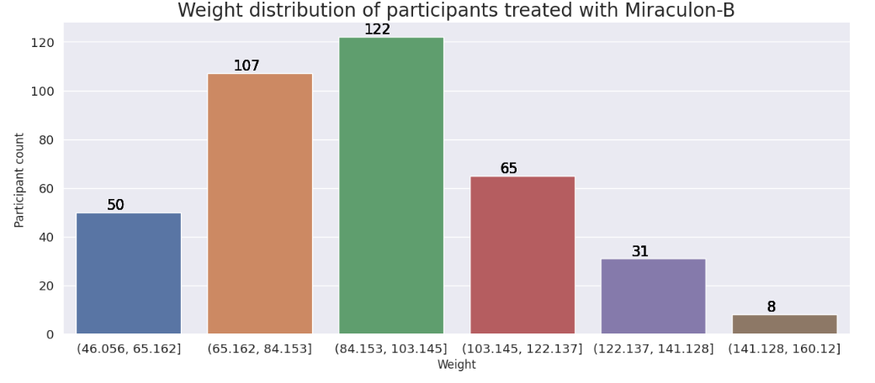
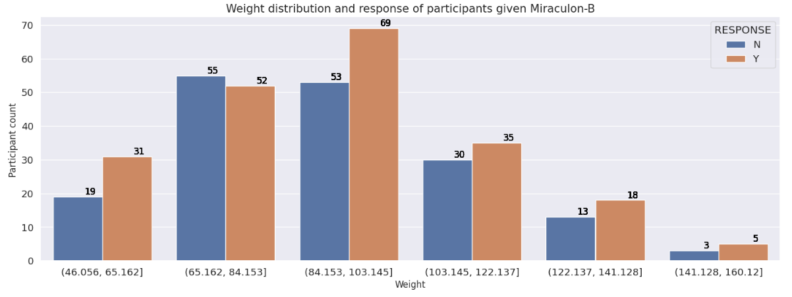
Weight
229 of participants weigh between 107kg and 122 kg

Slide 23
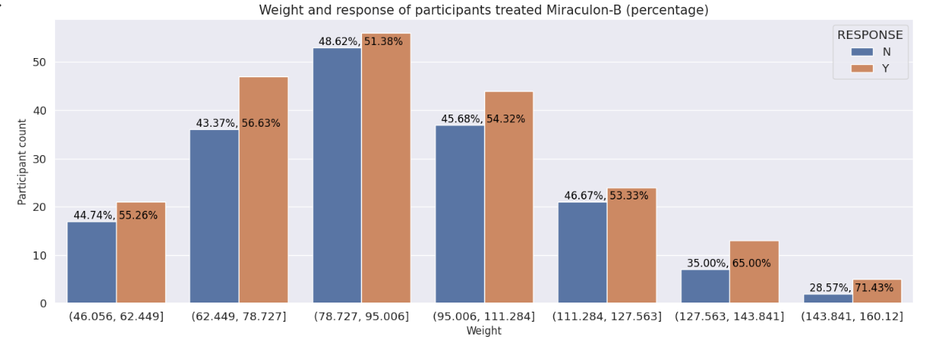
Weight

Slide 24
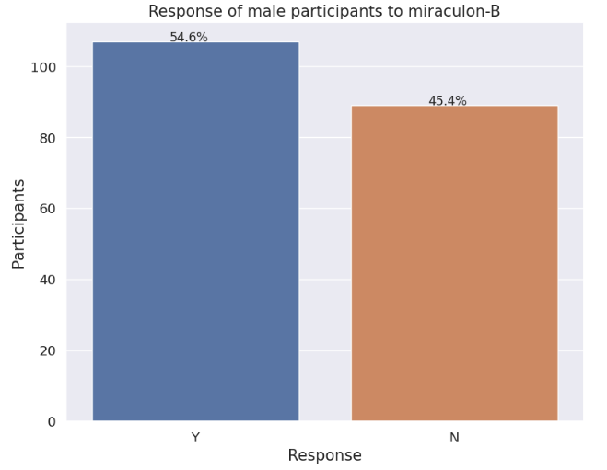
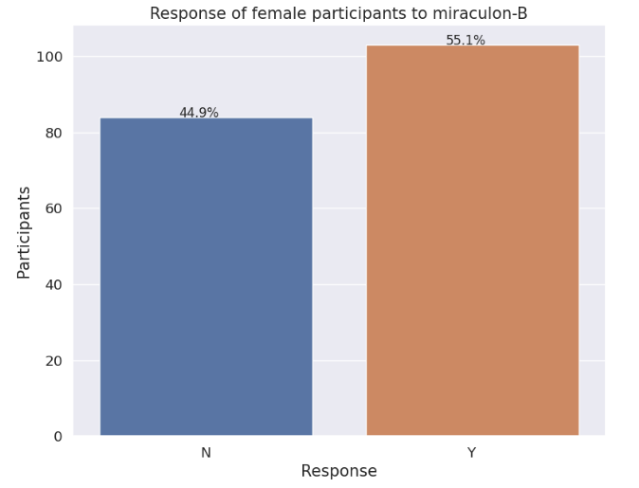
sex
The response for male and female participants is 54.6% and 55.1% respectively

Slide 25
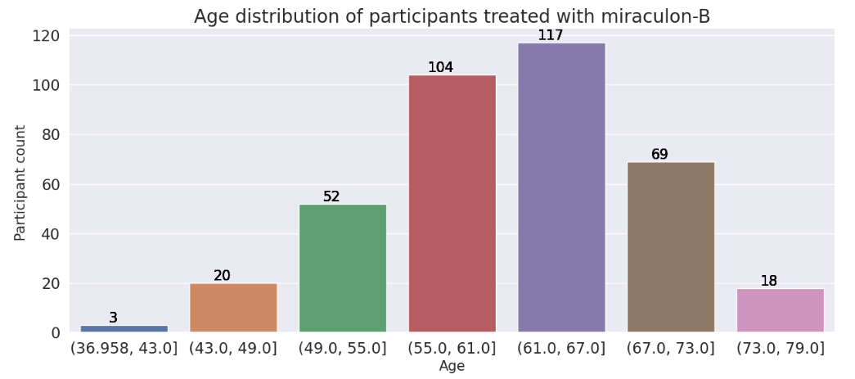
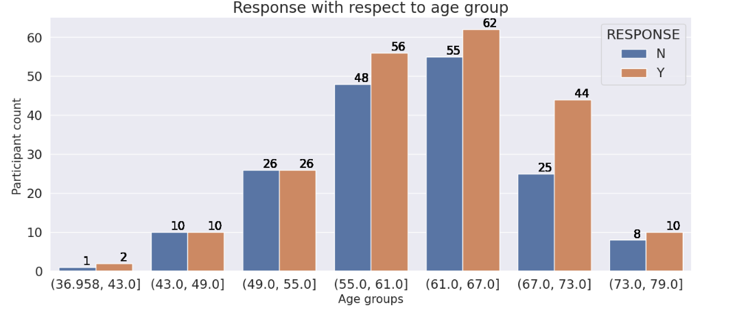
Age
221 of the participants are between 55 and 61 years old

Slide 26
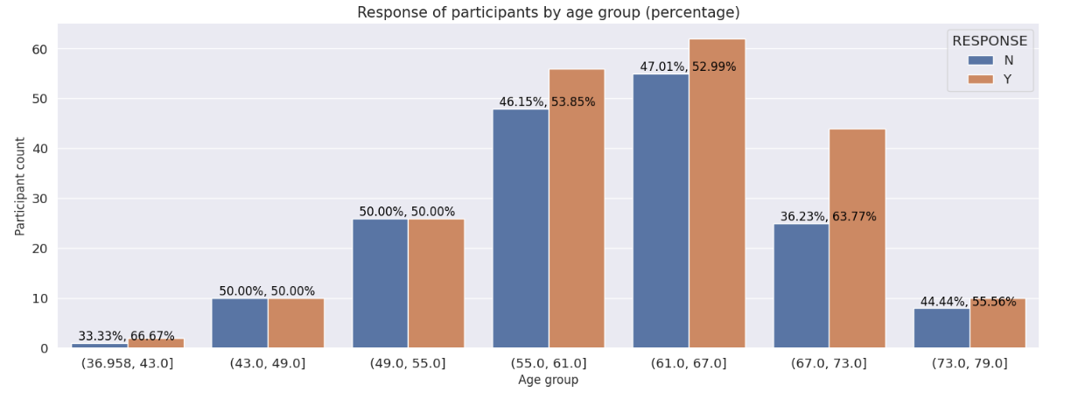
Age
Participants between 67 and 73 years of age had the most benefit of 63.77%

Slide 27
Analyzing data of participants treated with standard care

Slide 28
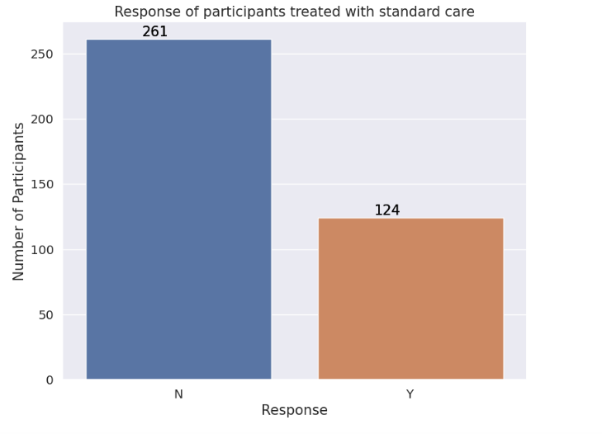
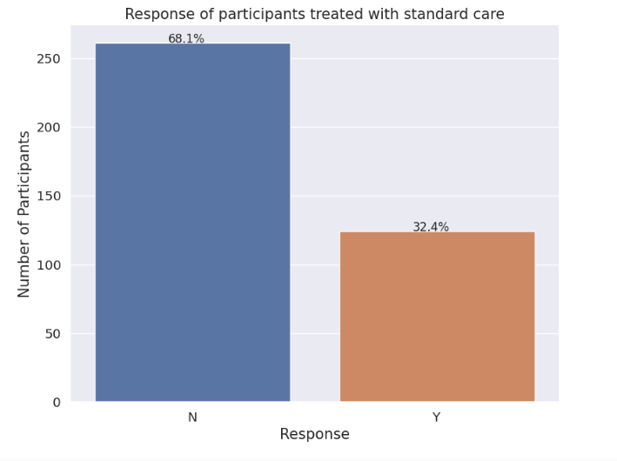
Participants treated with standard care (control)

Slide 29
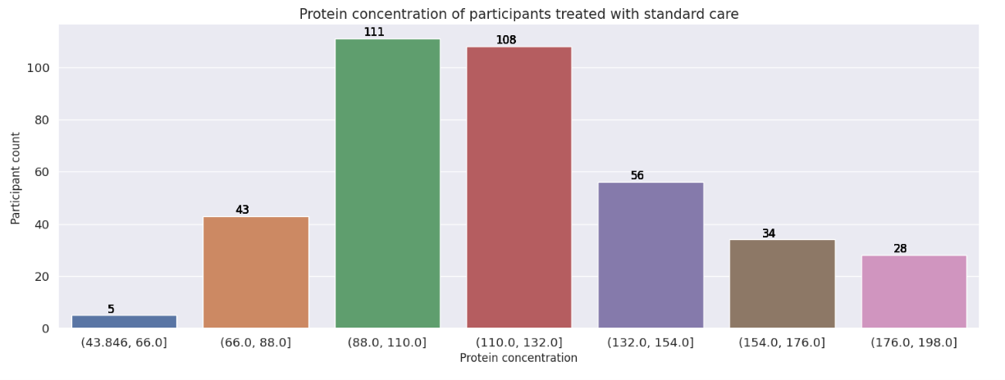
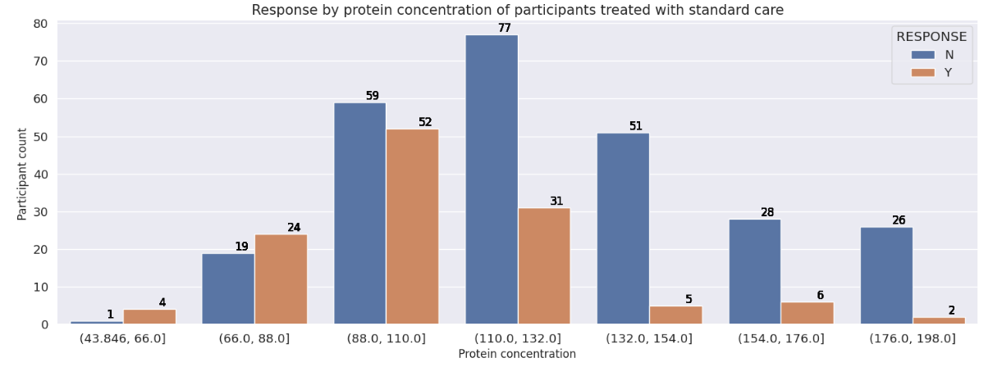
Protein concentration

Slide 30
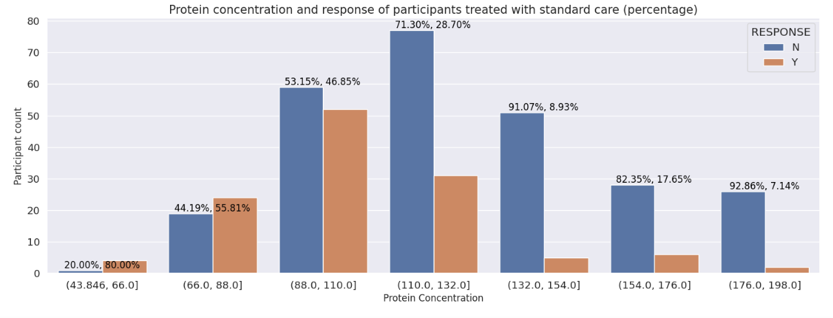
Protein concentration

Slide 31
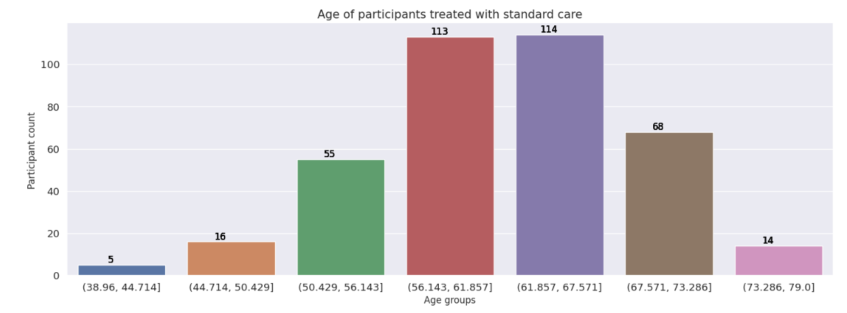
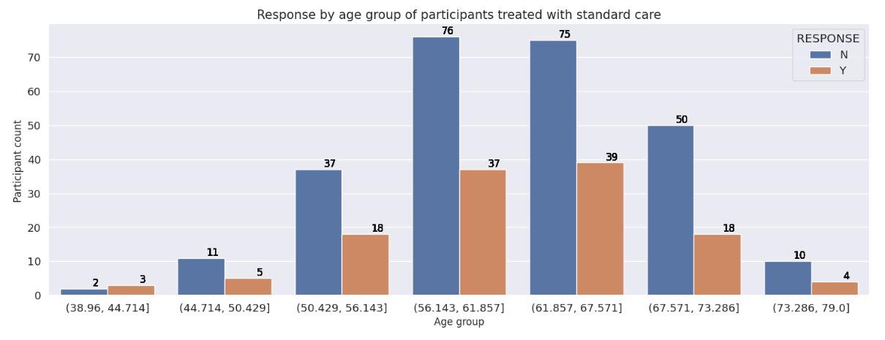
Age

Slide 32
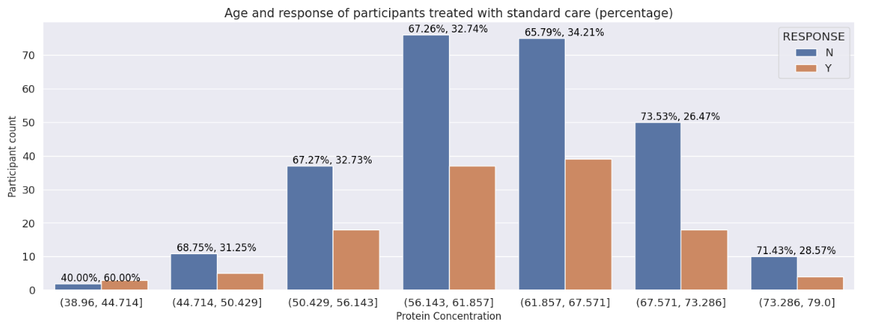
Age

Slide 33
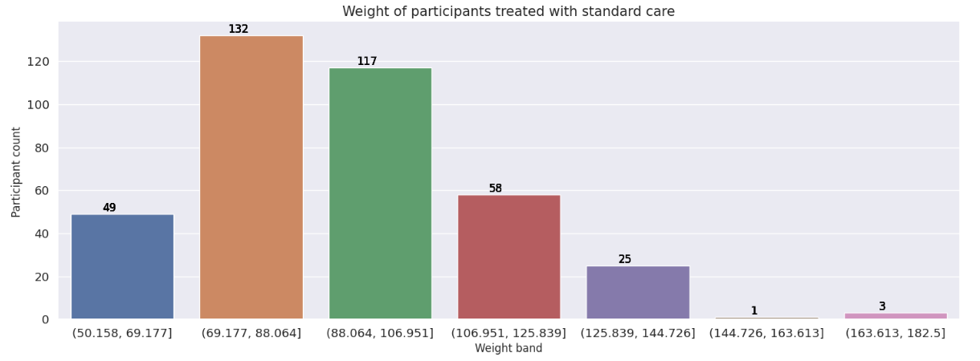
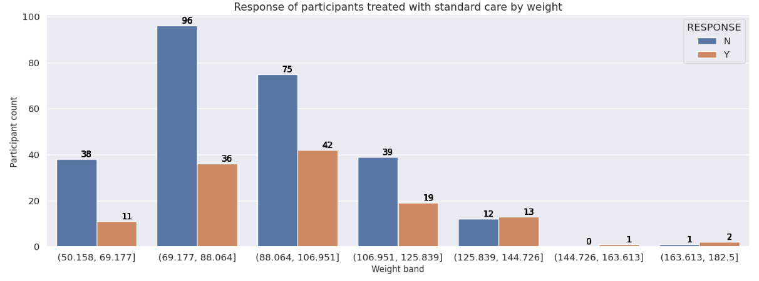
Weight

Slide 34
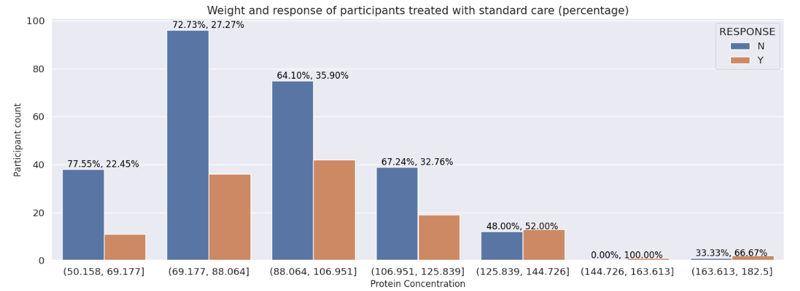
Weight

Slide 35

Predictive model development

Slide 36

A model to predict if a patient will respond to treatment with miraculon-B was developed. Only data of participants treated with the drug was used to train and test the model.

Slide 37
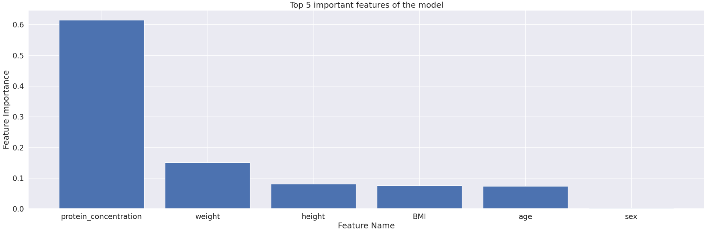
Machine learning technique was used to identify key drivers. The result shows that protein concentration is the main feature that drives the model

Slide 38
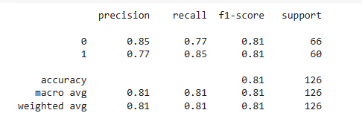
A few classifiers including Decision tree, Random forest and Gradient boosted decision trees were used to develop the model. Result of the best performing model was selected.

Slide 39
A few classifiers including Decision tree, Random forest and Gradient boosted decision trees were used to develop the model.

Slide 40
Interpretation of Results

Slide 41
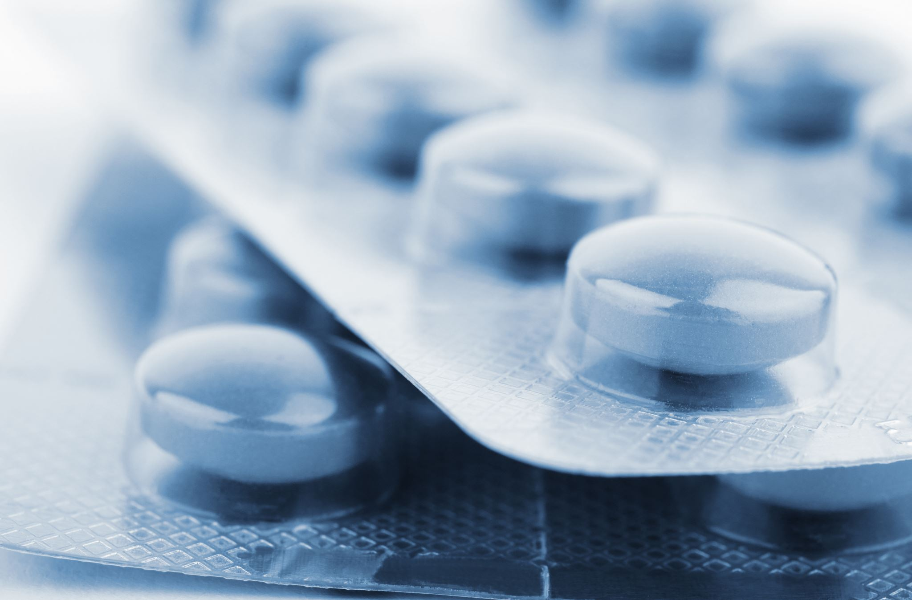
Miraculon-B performed better in the treatment of solid tumour than the standard care. 54.8% of participants treated with it responded positively while only 32.4% of those treated with the control responded.

Slide 42
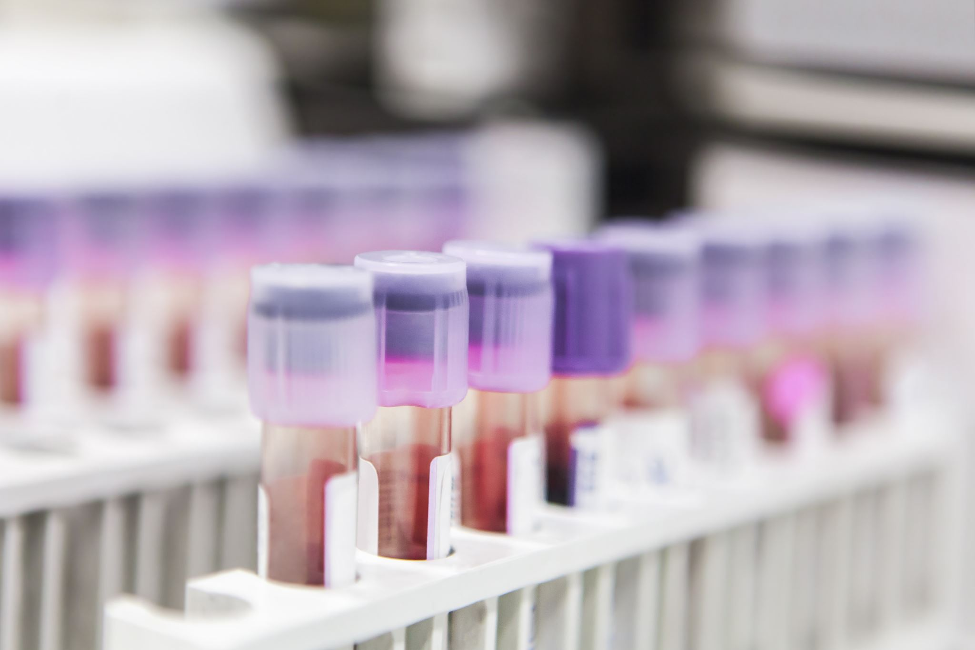
Blood protein concentration is a predictive biomarker. Those with protein concentration between 55.86(ug/L) and 76.43(ug/L) benefitted the most.
Analysis shows that all participants within this range responded to treatment while 92.86% of participants with protein concentration between 76.43(ug/L) and 96.86(ug/L) responded to treatment.
Those with protein concentration between 96.86(ug/L) and 117.29(ug/L) recorded 77.98% response.

Slide 43
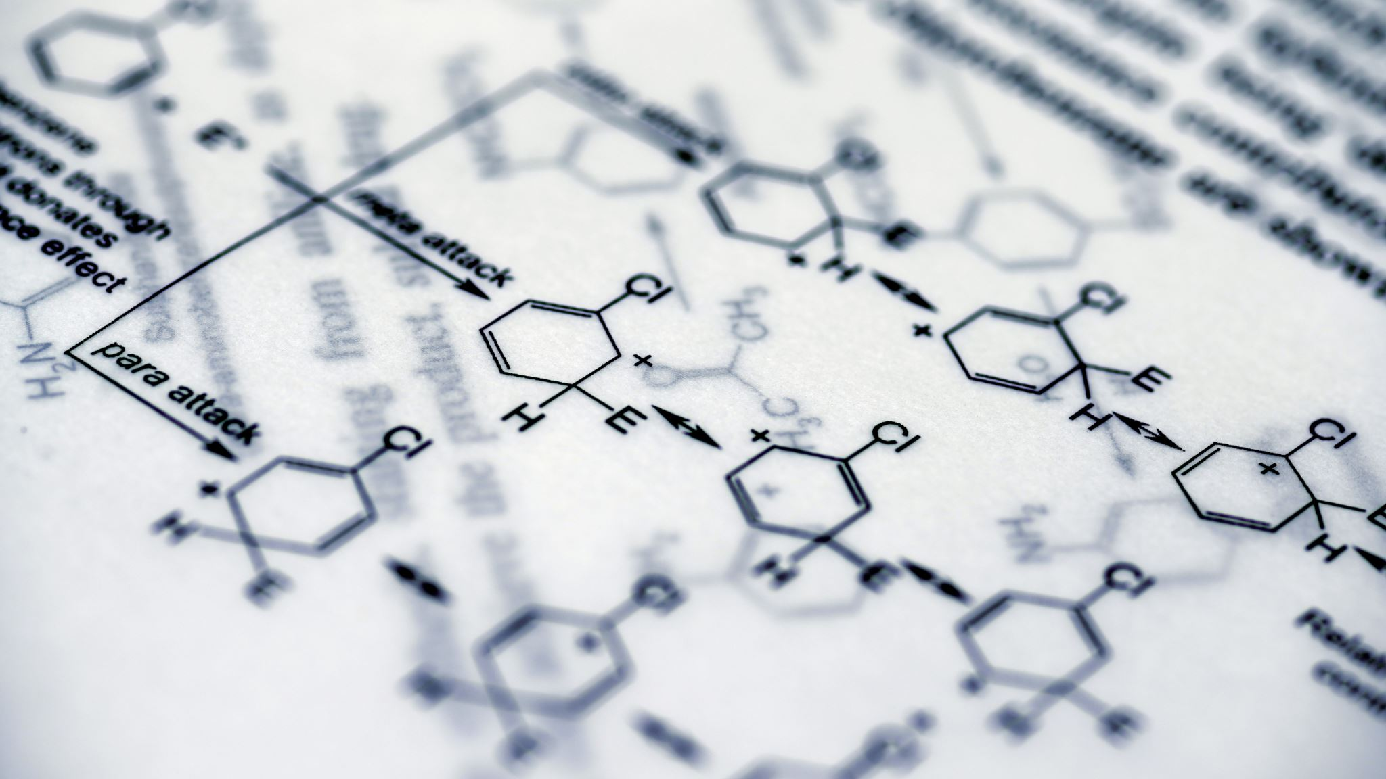
Interpretation of results
As the protein concentration increases above 117.29(ug/L) there is a decline in response to treatment. For instance, all participants with protein concentration above 178.57(ug/L) did not respond to miraculon-B.

Slide 44
Interpretation of results
In a nutshell, patients with protein concentration between 55.857(ug/L) and 117.286(ug/L) will benefit from treatment with miraculon-B.

Slide 45
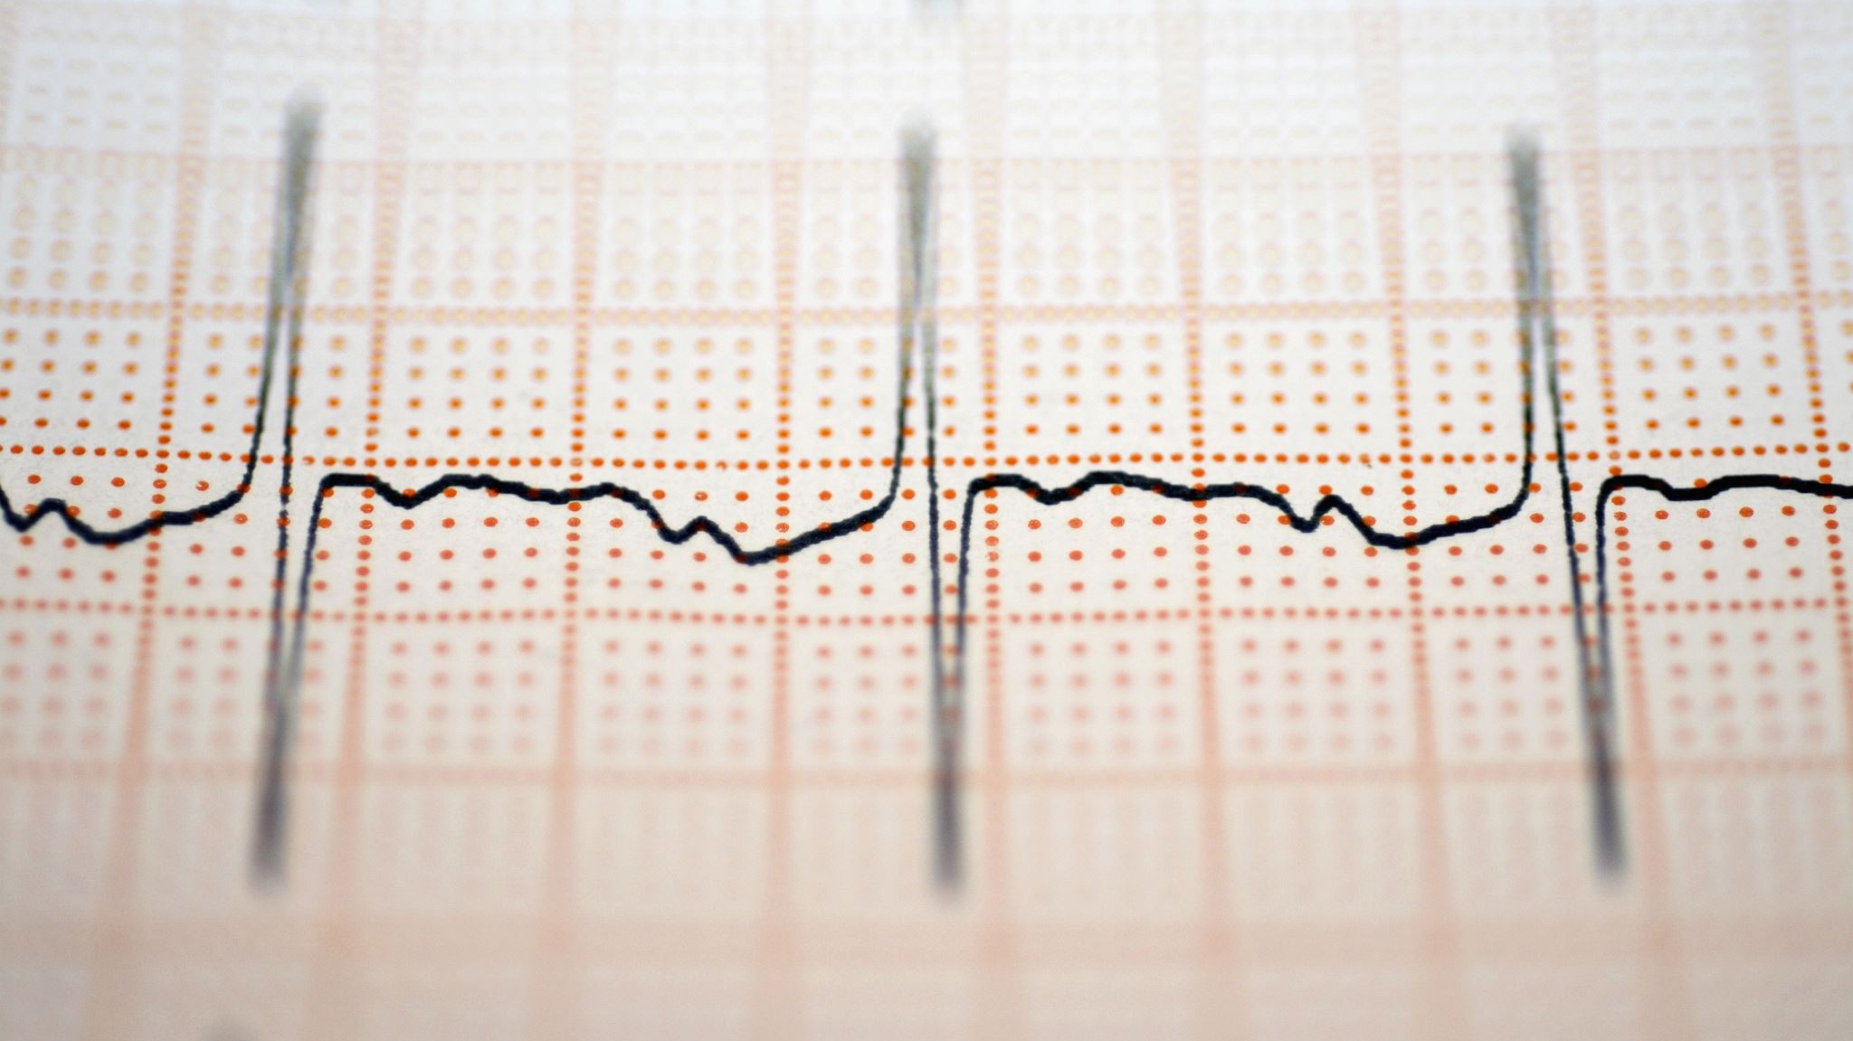
Weight
Although increase in weight does not directly show increase in percentage response response, a common pattern was observed in each of the sub-groups which is separated by the type of treatment. The pattern shows that participants whose weight fall within the highest range also responded better to treatment. For instance, for those treated with miraculon-B, the highest weight, which is between the range of 143.84kg and 160.12kg has the highest positive response of 71.43%. Similar pattern was observed for those treated with control.

Slide 46

Age and sex
Among participants treated with miraculon-B those between 67 and 73 years of age had the most benefit of 63.77% response.
Sex does not affect the response of participants to treatment.

Slide 47
Age and sex
Among participants treated with miraculon-B those between 67 and 73 years of age had the most benefit of 63.77% response.
Sex does not affect the response of participants to treatment.

Slide 48

Power BI Dashboard

Slide 49
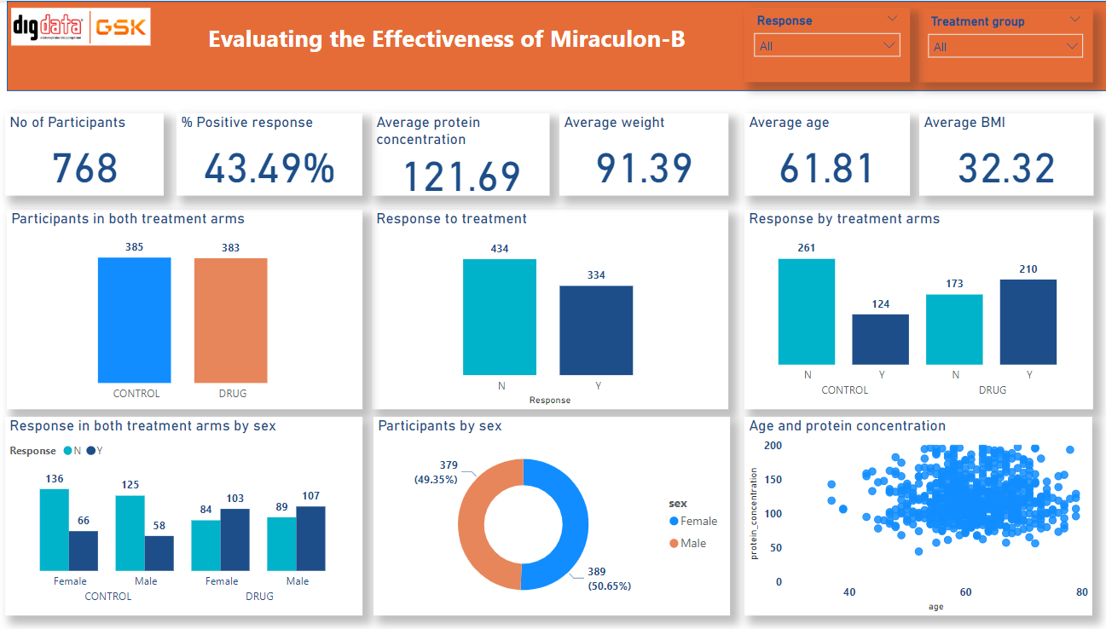

Slide 50
Conclusion
Miraculon-B is a potential drug for treatment of solid tumor. Those treated with it responded better compared to those with standard treatment.
The protein concentration of patients can be used to predict if they will respond to treatment or not. Those with lower protein concentration benefitted more. Specifically, protein concentration between 55.857 and 76.429 had 100% response while those between 76.429(ug/L) and 96.857(ug/L) had 92.8% response.

Slide 51

Conclusion
Sex, age and weight can not reliably predict whether a patient will respond to treatment or not. However, there is a higher chance for those between the age of 67 and 73 years to benefit more from miraculon-B. Similarly, patients that weigh above 127.56kg are better candidates to benefit from it.

Slide 52
Thank you!

